Slide 1

Formulate 20 problem statements for a given dataset using Numpy and Pandas and Apply Numpy and pandas methods to find the solution for the formulated problem statements.
Each one will take a real-life dataset.
Movie Review
NAME :- ROHAN . D . MANDHARE
ROLL NO :- CC-55
PRN :- 202401050020
BATCH :- CC-3
DATASET :- Movie Review

Slide 2
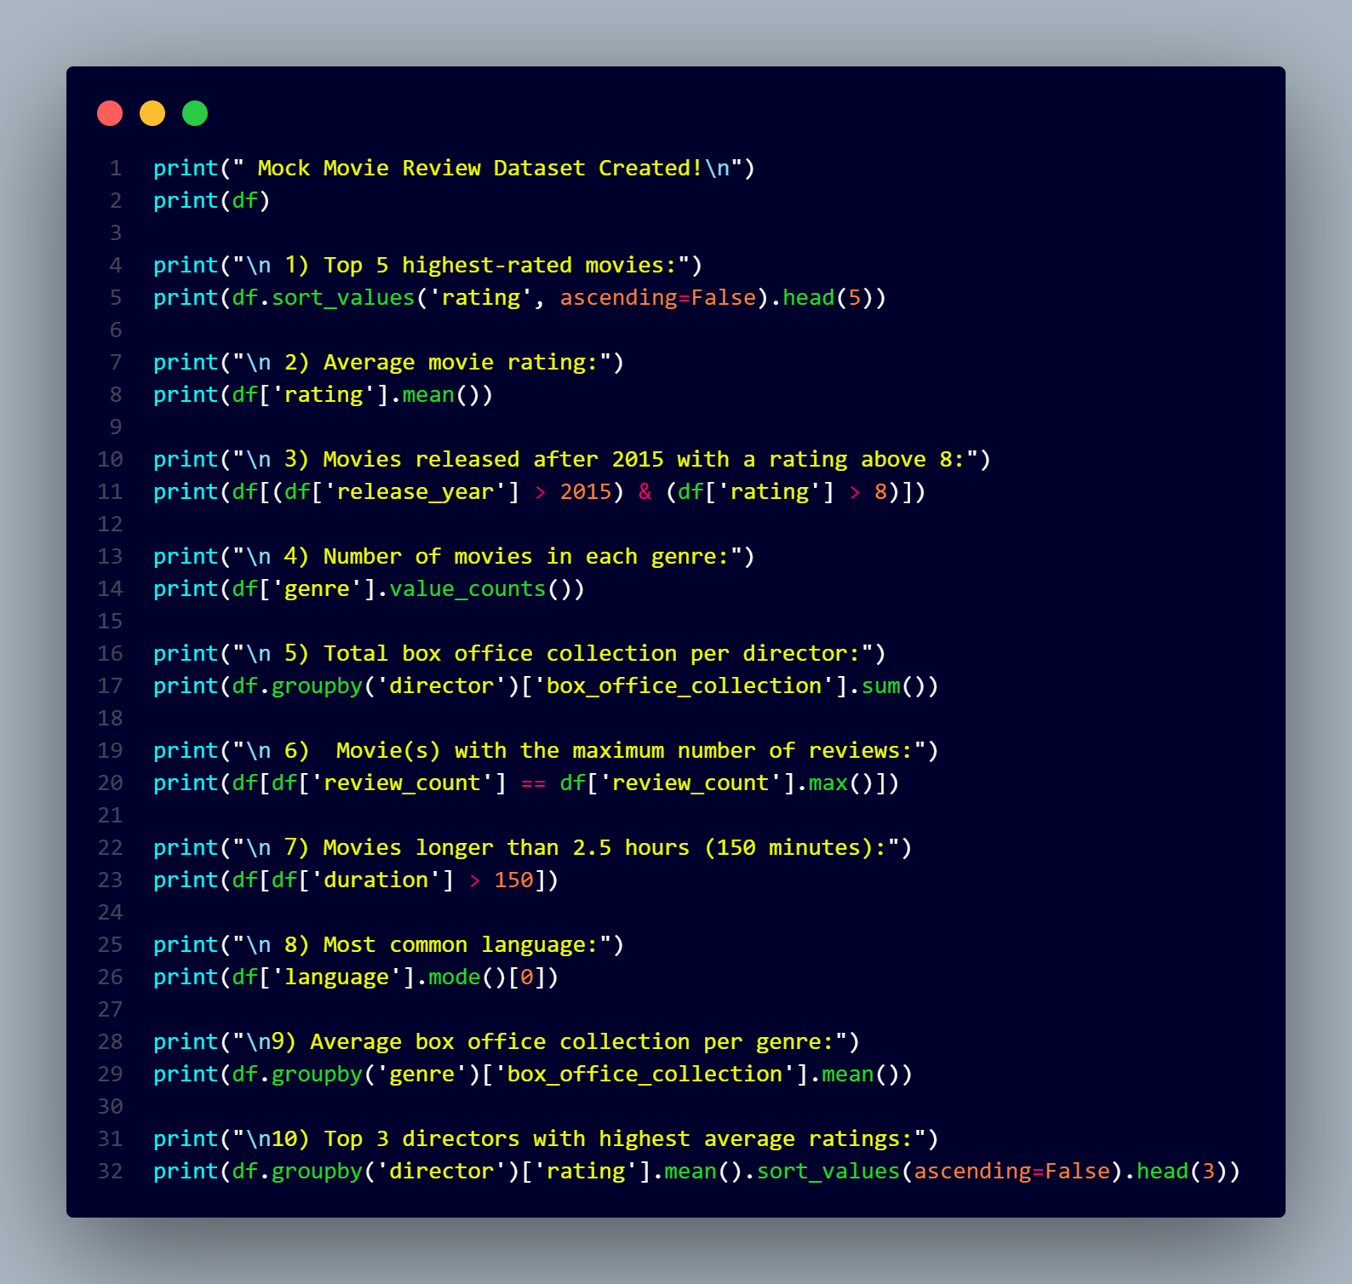
Problem Statements

Slide 3
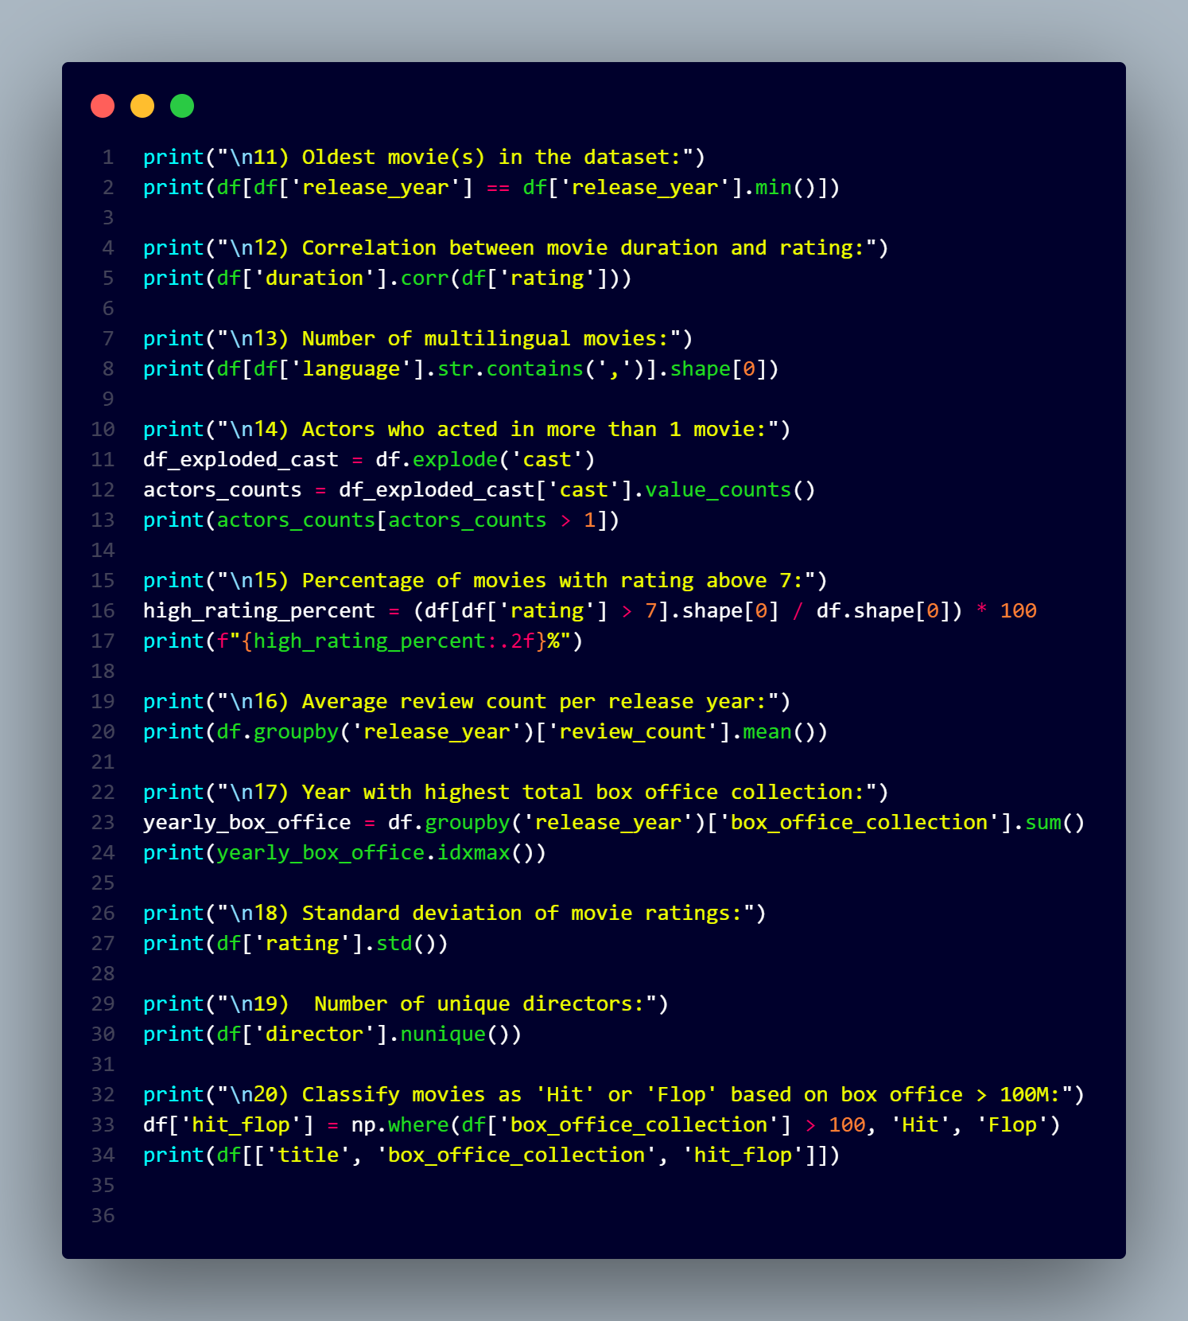

Slide 4
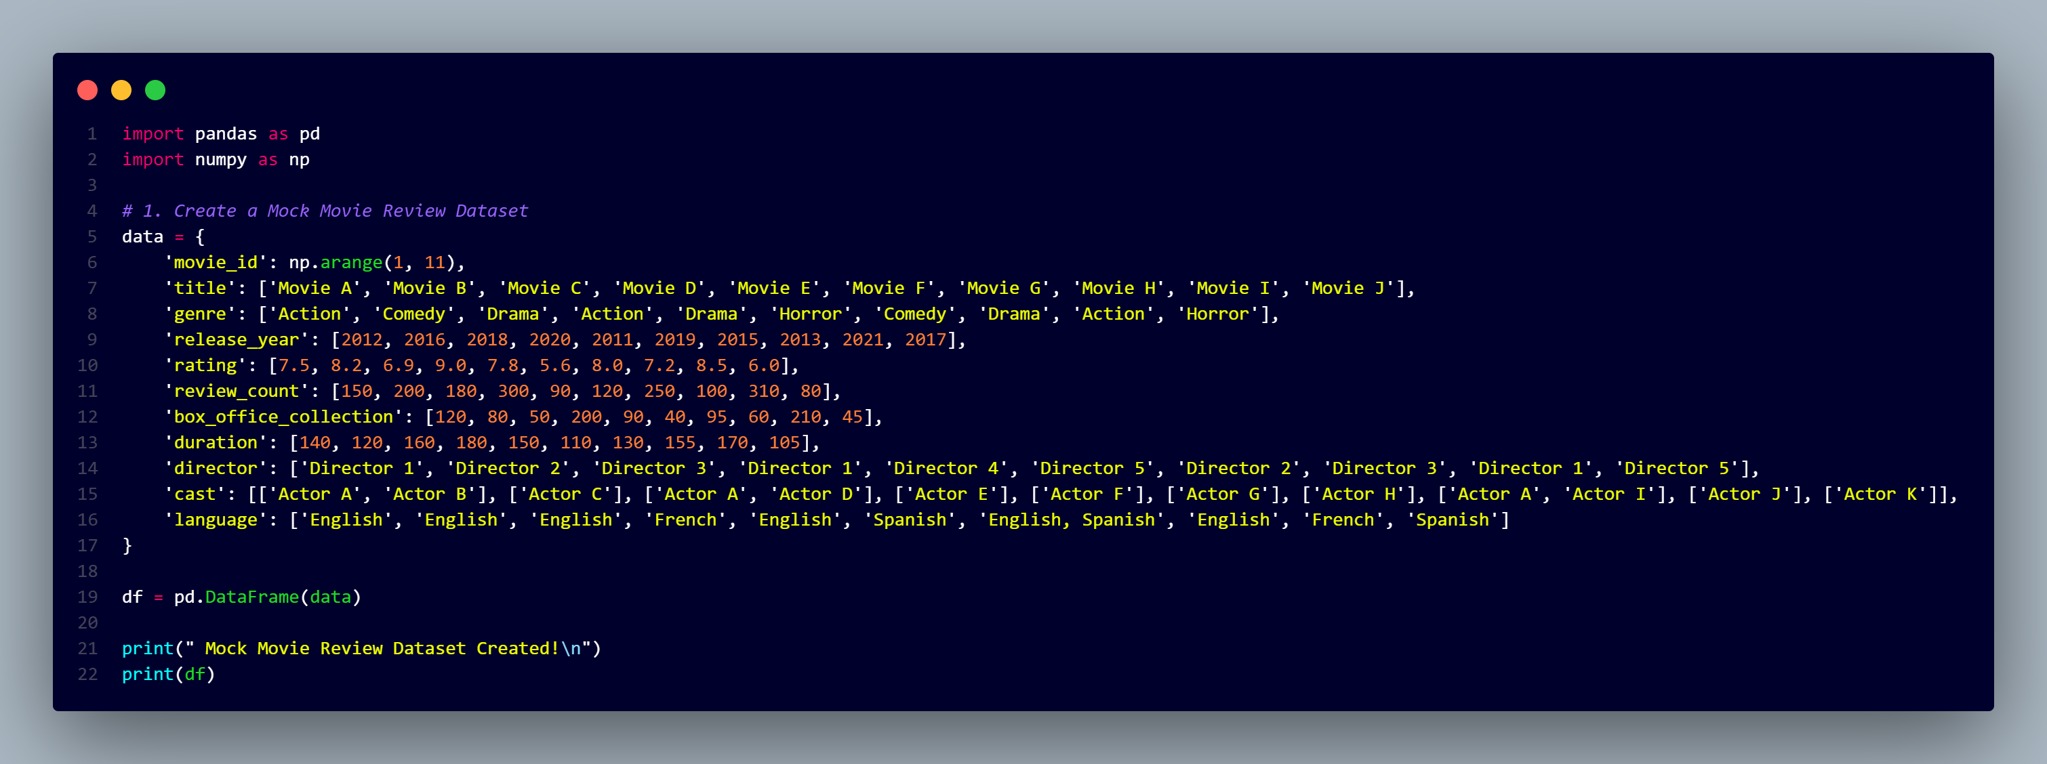
# Create a Mock Movie Review Dataset

Slide 5
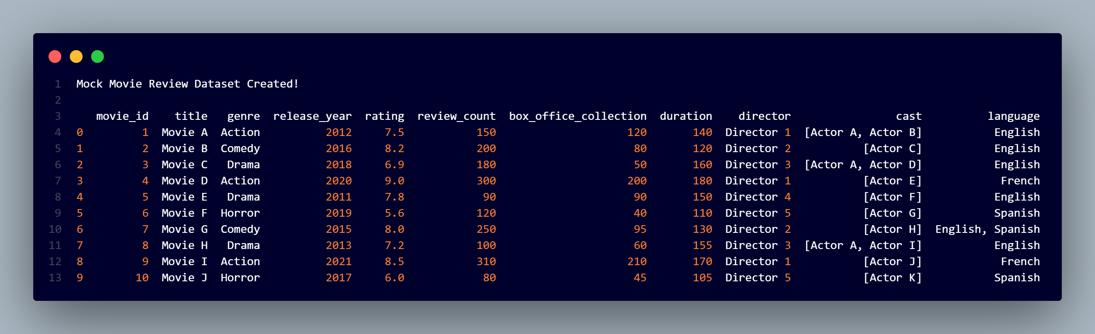
# OutPut of Mock Movie Review Dataset

Slide 6
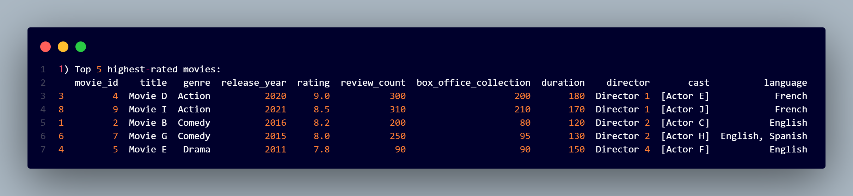
1. Top 5 highest-rated movies
print("\n 1) Top 5 highest-rated movies:")
print(df.sort_values('rating', ascending=False).head(5))
# OutPut

Slide 7
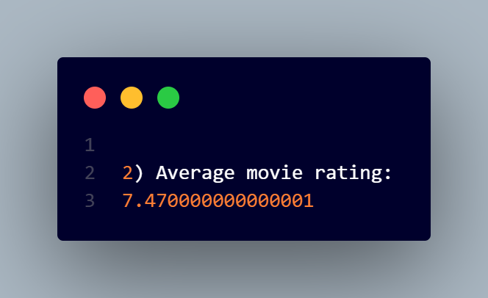
2. Average movie rating
print("\n 2) Average movie rating:")
print(df['rating'].mean())
# OutPut :-

Slide 8
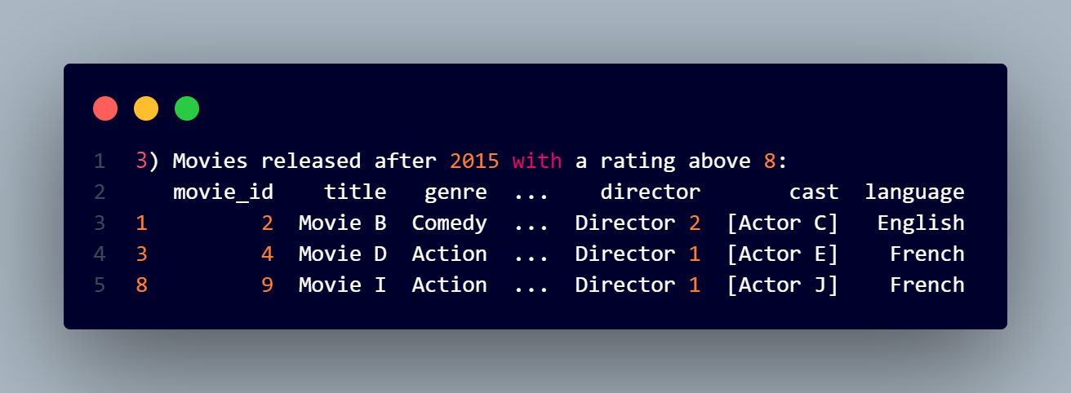
3. Movies released after 2015 with a rating above 8
print("\n 3) Movies released after 2015 with a rating above 8:")
print(df[(df['release_year'] > 2015) & (df['rating'] > 8)])
# OutPut :-

Slide 9
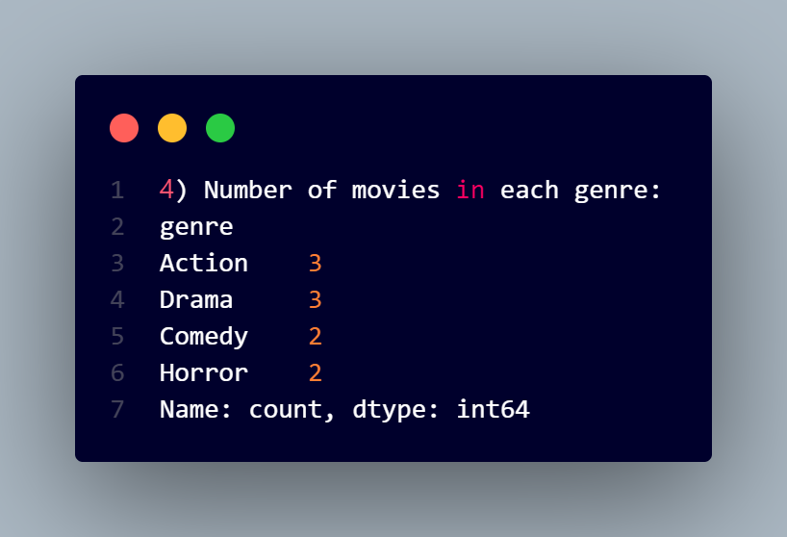
4. Number of movies in each genre
print("\n 4️) Number of movies in each genre:")
print(df['genre'].value_counts())
#OutPut :-

Slide 10
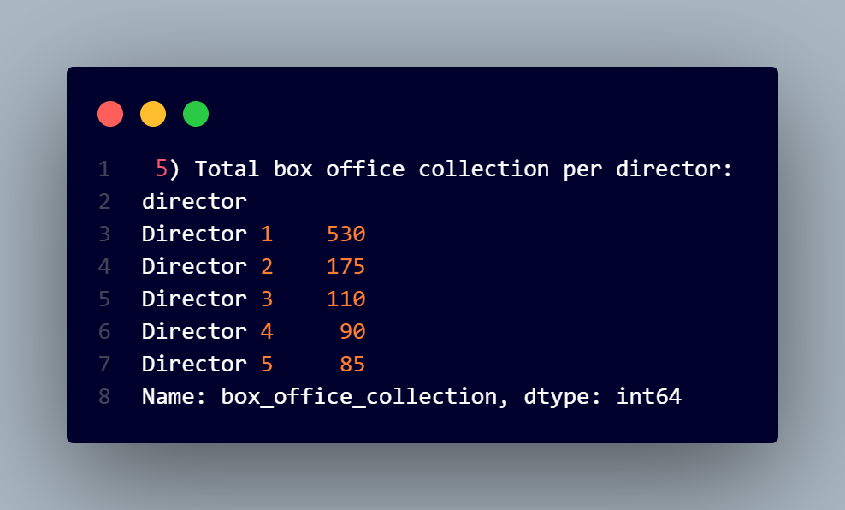
5. Total box office collection per director
print("\n 5) Total box office collection per director:")
print(df.groupby('director')['box_office_collection'].sum())
# OutPut :-

Slide 11
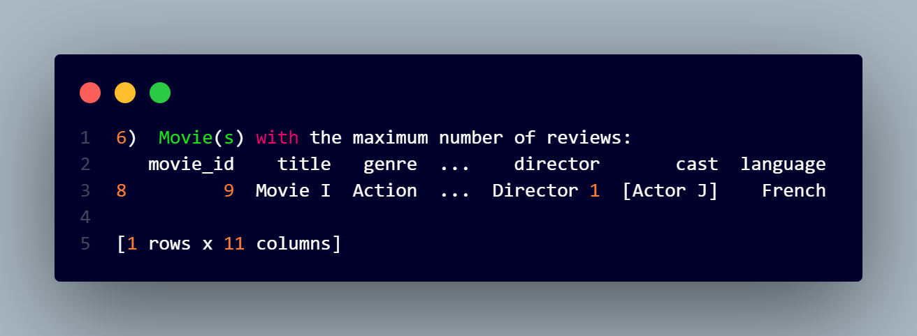
6. Movie(s) with the maximum number of reviews
print("\n 6) Movie(s) with the maximum number of reviews:")
print(df[df['review_count'] == df['review_count'].max()])
# OutPut :-

Slide 12
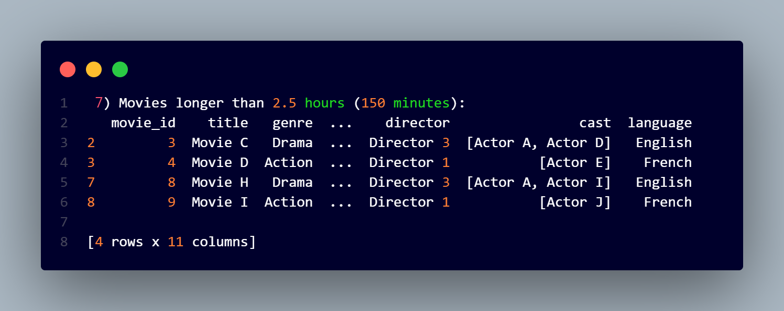
7. Movies longer than 2.5 hours (150 minutes)
print("\n 7️) Movies longer than 2.5 hours (150 minutes):")
print(df[df['duration'] > 150])
# OutPut :-

Slide 13
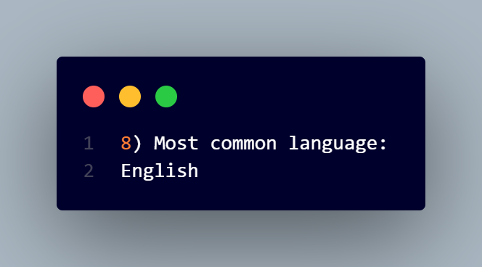
8. Most common language
print("\n 8) Most common language:")
print(df['language'].mode()[0])
# OutPut :-

Slide 14
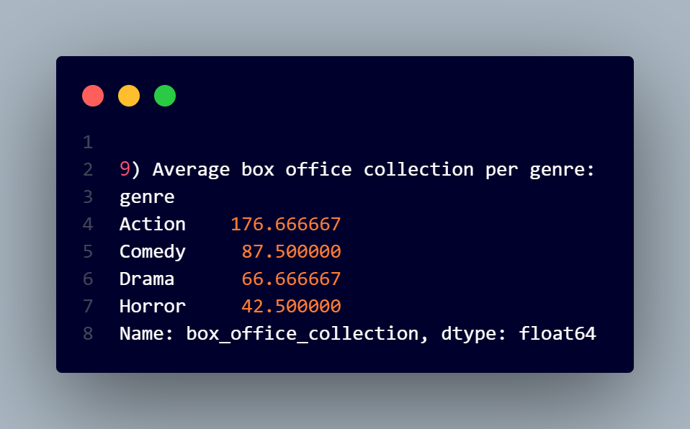
9. Average box office collection per genre
print("\n9) Average box office collection per genre:")
print(df.groupby('genre')['box_office_collection'].mean())
# OutPut :-

Slide 15
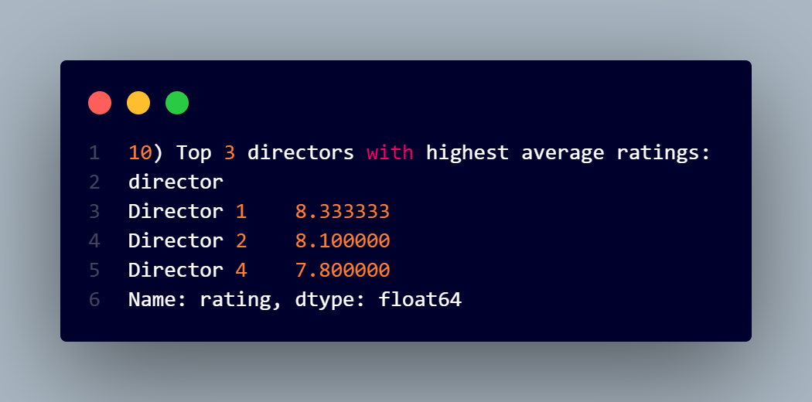
10. Top 3 directors with highest average ratings
print("\n10) Top 3 directors with highest average ratings:")
print(df.groupby('director')['rating'].mean().sort_values(ascending=False).head(3))
# OutPut :-

Slide 16
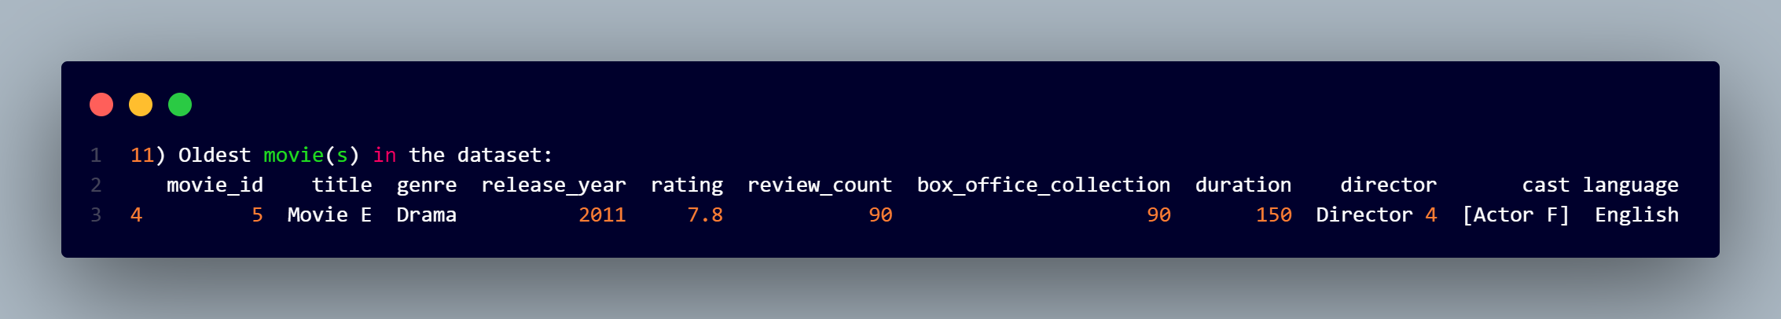
11. Oldest movie(s) in the dataset
print("\n11) Oldest movie(s) in the dataset:")
print(df[df['release_year'] == df['release_year'].min()])
# OutPut :-

Slide 17
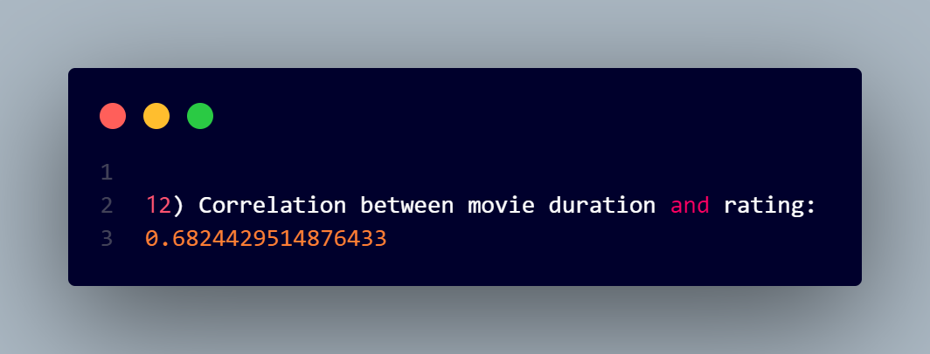
12. Correlation between movie duration and rating
print("\n12) Correlation between movie duration and rating:")
print(df['duration'].corr(df['rating']))
# OutPut :-

Slide 18
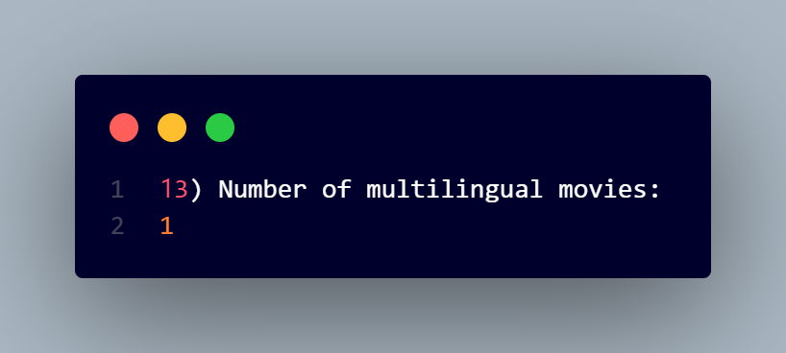
13. Number of multilingual movies
print("\n13) Number of multilingual movies:")
print(df[df['language'].str.contains(',')].shape[0])
# OutPut :-

Slide 19
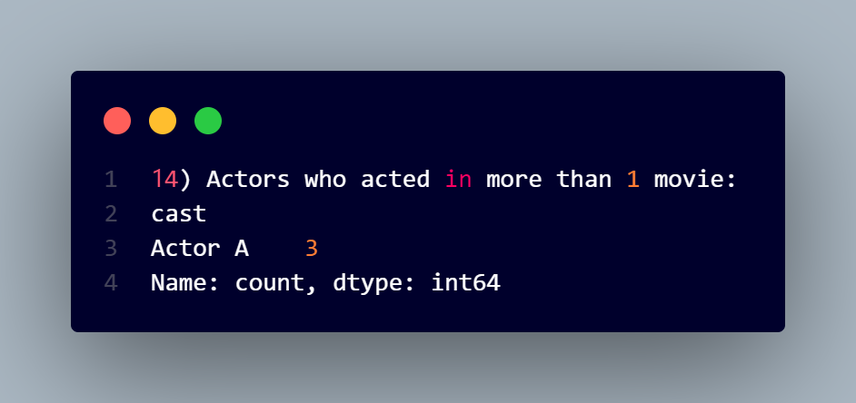
14. Actors who acted in more than 1 movie
print("\n14) Actors who acted in more than 1 movie:")
df_exploded_cast = df.explode('cast')
actors_counts = df_exploded_cast['cast'].value_counts()
print(actors_counts[actors_counts > 1])
# OutPut :-

Slide 20
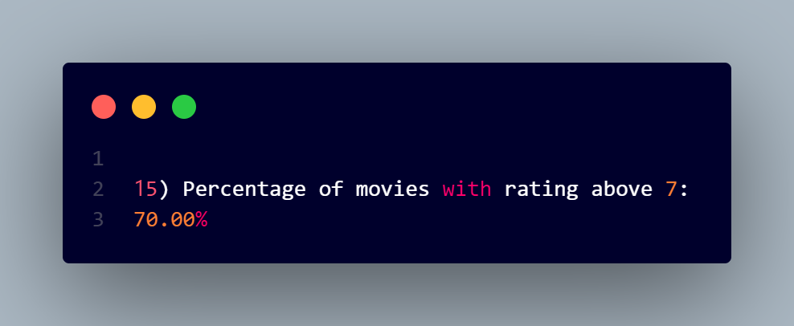
15. Percentage of movies with rating above 7
print("\n1️5) Percentage of movies with rating above 7:")
high_rating_percent = (df[df['rating'] > 7].shape[0] / df.shape[0]) * 100
print(f"{high_rating_percent:.2f}%")
# OutPut :-

Slide 21
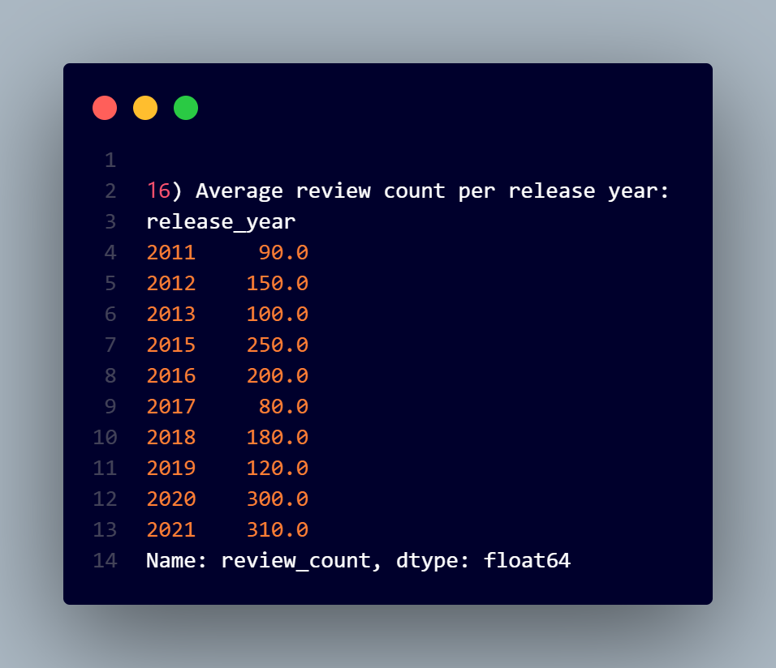
16. Average review count per release year
print("\n16) Average review count per release year:")
print(df.groupby('release_year')['review_count'].mean())
# OutPut :-

Slide 22
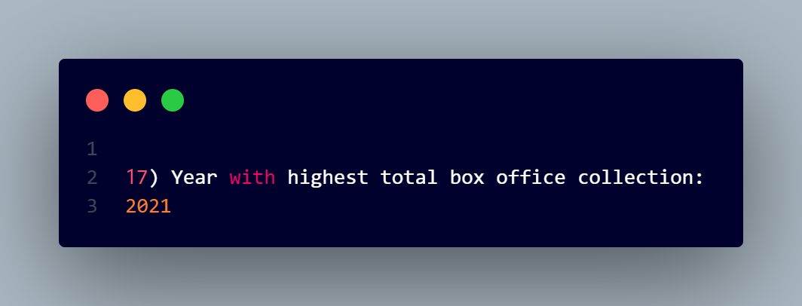
17. Year with highest total box office collection
print("\n17) Year with highest total box office collection:")
yearly_box_office = df.groupby('release_year')['box_office_collection'].sum()
print(yearly_box_office.idxmax())
# OutPut :-

Slide 23
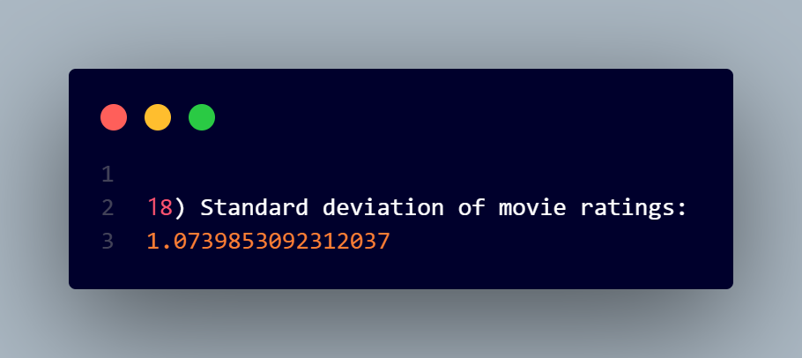
18. Standard deviation of movie ratings
print("\n18) Standard deviation of movie ratings:")
print(df['rating'].std())
# OutPut :-

Slide 24
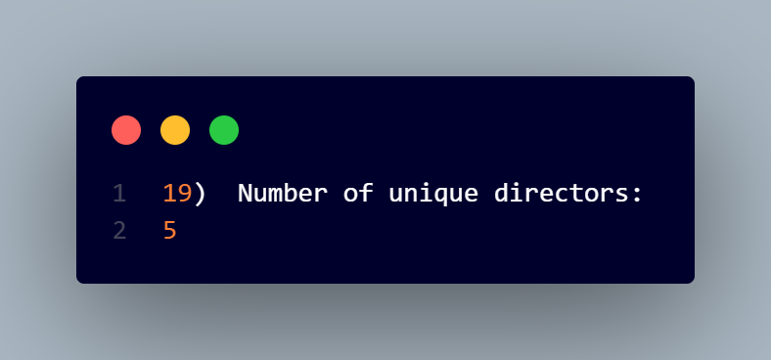
19. Number of unique directors
print("\n19) Number of unique directors:")
print(df['director'].nunique())
# OutPut :-

Slide 25
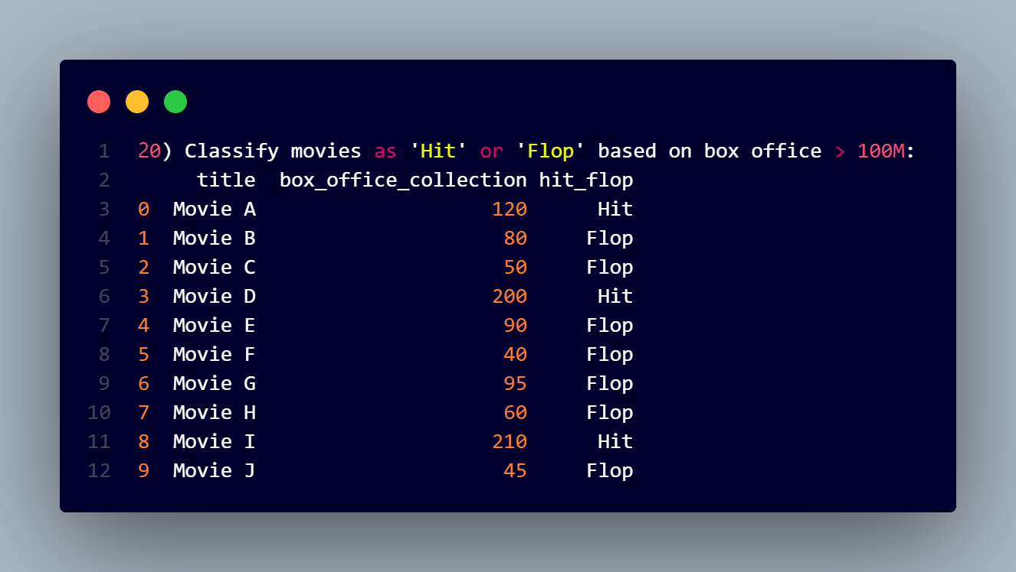
20. Classify movies as 'Hit' or 'Flop' based on box office > 100M
print("\n20) Classify movies as 'Hit' or 'Flop' based on box office > 100M:")
df['hit_flop'] = np.where(df['box_office_collection'] > 100, 'Hit', 'Flop')
print(df[['title', 'box_office_collection', 'hit_flop']])
#OutPut :-

